Slide 1
BDAA Spring ’17 Workshop Series iII: Data Visualization
How to visualize cleaned data

Slide 2
What is Data VISUalization?

Slide 3
Data Visualization Definition:
Data visualization refers to the techniques used to communicate data or information by encoding it as visual objects (e.g., points, lines or bars) contained in graphics. The goal is to communicate information clearly and efficiently to users. It is one of the steps in data analysis or data science.
"main goal of data visualization is to communicate information clearly and effectively through graphical means. It doesn't mean that data visualization needs to look boring to be functional or extremely sophisticated to look beautiful. To convey ideas effectively, both aesthetic form and functionality need to go hand in hand, providing insights into a rather sparse and complex data set by communicating its key-aspects in a more intuitive way. Yet designers often fail to achieve a balance between form and function, creating gorgeous data visualizations which fail to serve their main purpose — to communicate information". – Friedman (2008)
*Data Scientist: EDA, Visual confirmation*
*Your Boss, Client, Co-worker, etc: “the punch line”*

Slide 4
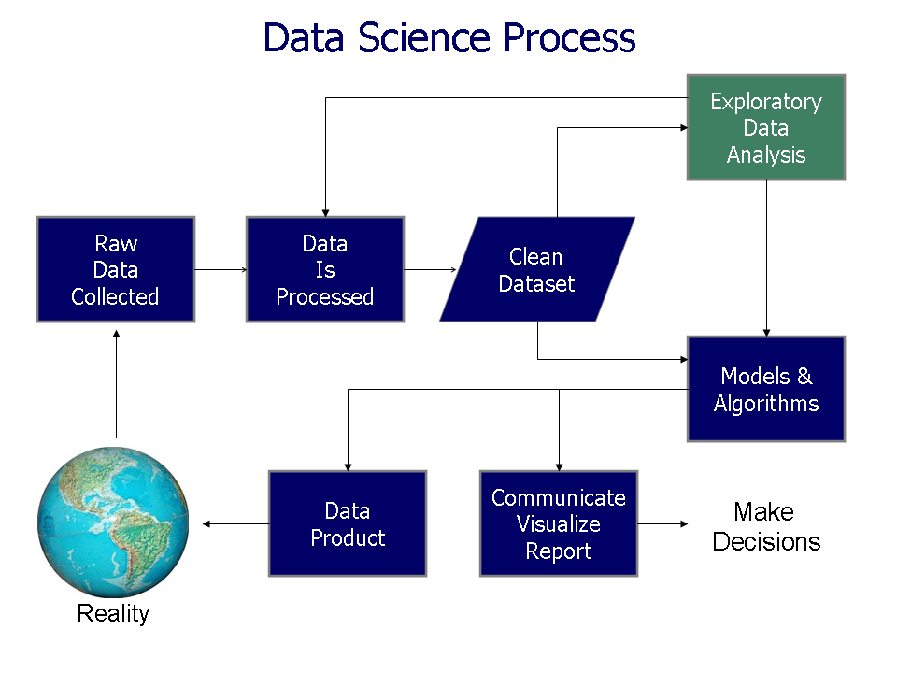

Slide 5
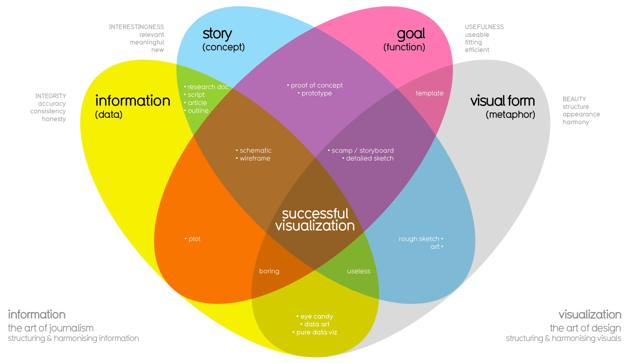
What Makes a good Visualization?

Slide 6
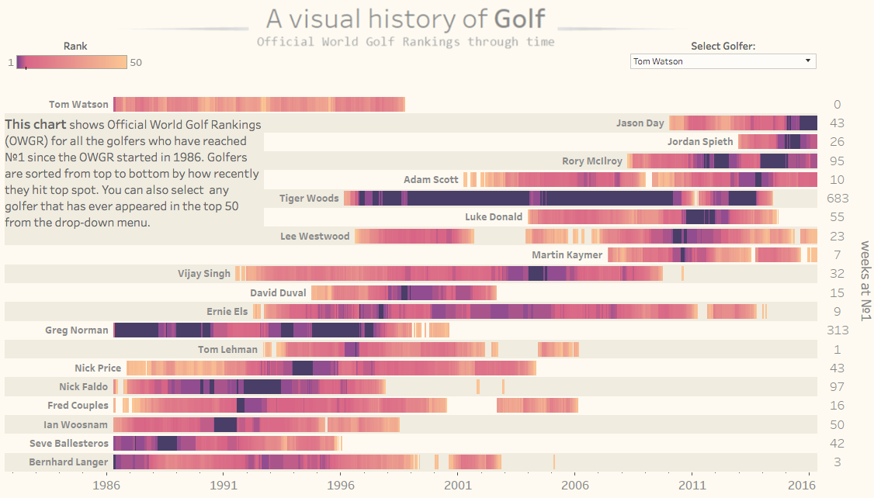
EXAMPLEs: https://public.tableau.com/en-us/s/gallery/world-golf-rankings

Slide 7
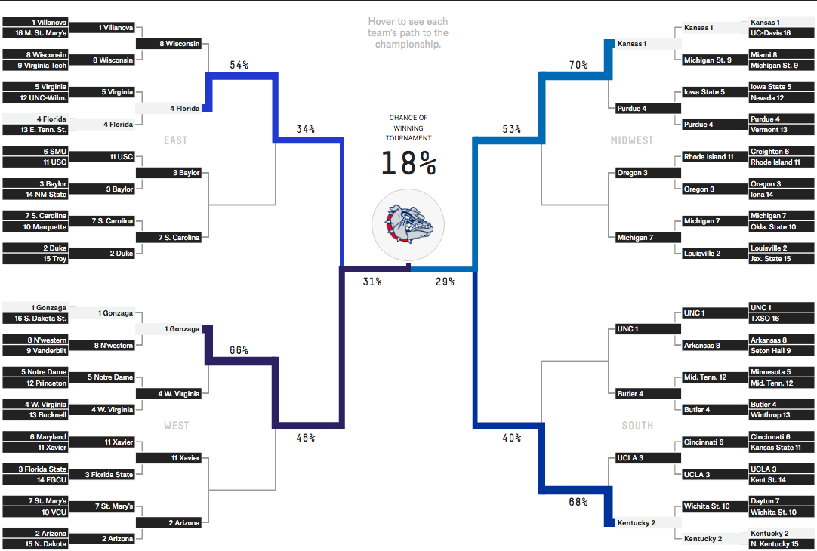
https://projects.fivethirtyeight.com/2017-march-madness-predictions/

Slide 8
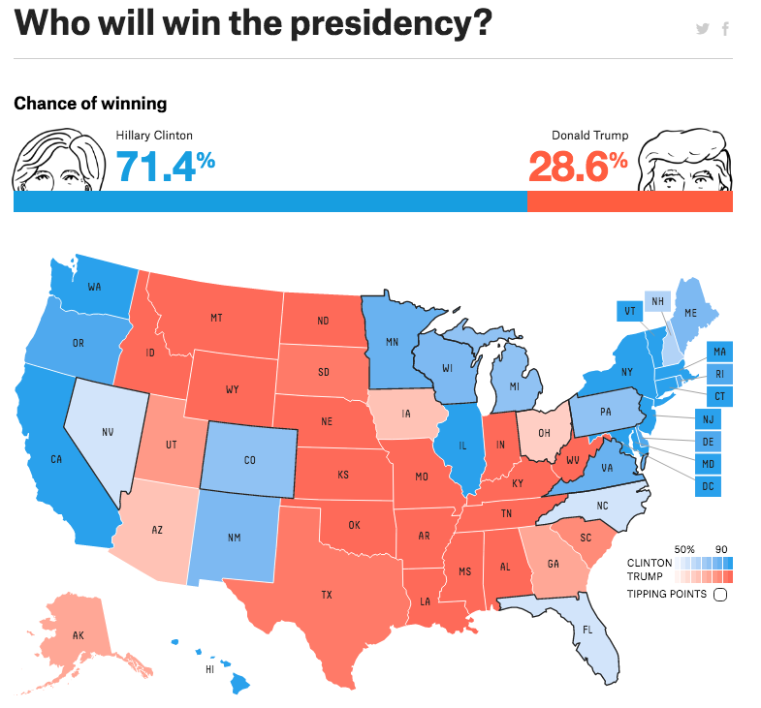
https://projects.fivethirtyeight.com/2016-election-forecast/

Slide 9
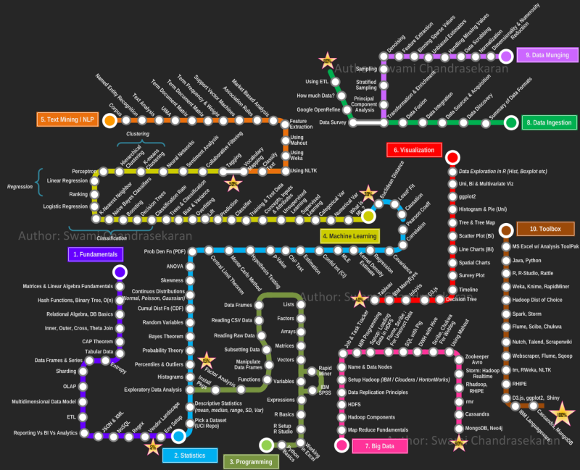
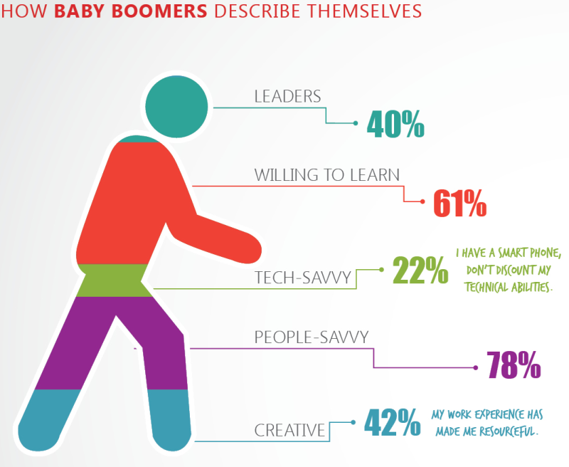
BAD visualizations:

Slide 10
METHODS:
Coding languages:
R, Python, Matlab, etc.
Often use packages such as ggplot
Software
Excel
Tableau
SAS, SPSS etc.
BI Services
Google Charts
Amazon Quicksight
Microsoft Power BI

Slide 11
GGPlot2 (Documentation: ggplot2.org)
Implementation of Grammar of Graphics by Leland Wilkinson
Written by Hadley Wickham at Iowa State
BASE: “artist’s palette” model
Start with blank canvas and layer things on
Plot then Lines, points, text, axes, legend,fix etc.
CANT go back one added
LATTICE: (boxplots etc)
All at once
QPLOT:
In GGPLOT package, for more basic graphs
GGPLOT: combination
Automatically deals with spacing, margins etc.
MUCH more customization and easier

Slide 12
LET THE GAMES BEGIN!
github.com/kalmanroemer/BDAAEducation

Slide 13
Explore!
http://ggplot2.org/
https://public.tableau.com/en-us/s/gallery
https://www.census.gov/dataviz/
https://fivethirtyeight.com/

